Slide 1

Classical Conditioning: Stimulus Effects
ATPSY Year 12 ATAR Psychology

Slide 2

Review
Exam Questions:10 minutes

Slide 3
Learning Intentions
stimulus generalisation, discrimination, extinction and spontaneous recovery

Slide 4
Success Criteria
Define stimulus generation and give an example.
Define stimulus discrimination and give an example.
Define extinction and describe conditions under which it would occur.
Define spontaneous recovery and apply it to Pavlov’s dog experiment.

Slide 5
Stimulus Generalisation
responses to stimuli that are similar to the original conditioned stimulus

Slide 6
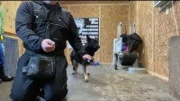

Slide 7
Stimulus discrimination
the ability to distinguish between one stimulus and similar stimuli.

Slide 8
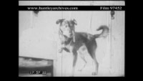
Trigger warning: Disturbing content

Slide 9
Extinction
the decrease in the conditioned response when the unconditioned stimulus is no longer presented with the conditioned stimulus. In classical conditioning terms, there is a gradual weakening and disappearance of the conditioned response.

Slide 10
Spontaneous recovery
the return of a previously extinguished conditioned response following a rest period

Slide 11
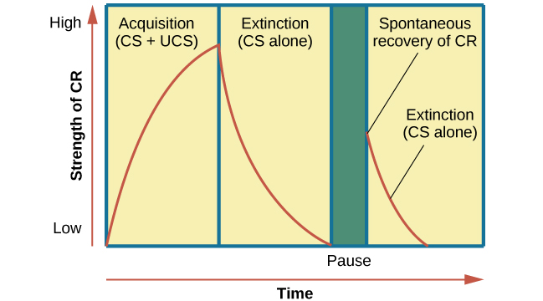

Slide 12

What does spontaneous recovery suggest about learning?

Slide 13
Success Criteria
Define stimulus generation and give an example.
Define stimulus discrimination and give an example.
Define extinction and describe conditions under which it would occur.
Define spontaneous recovery and apply it to Pavlov’s dog experiment.

